Slide 1

SDCC Sepsis Initiative
Protecting and Treating Sepsis in our SDCC Communities

Slide 2
Learning Objectives
Understand what sepsis is and the body’s response to infection
Identify how resident’s may be at risk for sepsis
Identify the impact of sepsis on our residents
Recognize the spectrum of sepsis and the importance of early identification
Recognize the 3 100’s of early detection
Identify the treatment for sepsis
List preventative sepsis interventions
Become comfortable with the SDCC selected sepsis tools
Understand the goal to train your clinical teams

Slide 3
What is Sepsis?
Sepsis is the body’s over-whelming and life threatening response to an infection which can lead to tissue damage, organ failure and death.

Slide 4
2 ways the body reacts to infection:
1st- Local Response
inflammation, redness, pus, pain at site of infection
2nd- Total Body Response
S.I.R.S-Systemic Inflammatory Response
Infection into the blood
Total body response to infection

Slide 5
Who is at risk for systemic infection reaction?
Compromised/weakened immune system
Overwhelming infection and/or resistant organisms
65 years old and older, young children and infants
Invasive tubes/procedures (foley catheters, IV’s, wounds)
Multiple Chronic Conditions (diabetes, heart failure, COPD)
Infections of the lung, skin, urinary and gastrointestinal systems (pneumonia, UTI, cellulitis, norovirus, c difficile, diarrhea)

Slide 6
Who is at risk for developing sepsis?
OUR RESIDENTS!!!

Slide 7
Sepsis and Seniors
64.9% of all sepsis cases are patients over 65
#1 reason for re-hospitalization in Colorado (Telligen)
80% of sepsis cases originate in the home and community
Nursing home residents in the Emergency department are 17 times as likely to be diagnosed with sepsis as non-nursing home patients

Slide 8
Sepsis must include both a suspected infection and SIRS symptoms
Infection: Most common infection sites: Lungs, Urinary Track, Skin, Gut
AND
S.I.R.S: Most common signs: Confusion, altered mental status, shortness of breath, high heart rate, fever, shivering, extreme pain or discomfort, clammy or sweaty skin

Slide 9
Sepsis Spectrum
Sepsis: Infection plus S.I.R.S.
    Severe Sepsis
          Septic Shock
                Multiple Organ Failure Death

Slide 10
Long Term Effects of Sepsis
Sepsis accounts for 60-70% of deaths/per year in the developing world
Each hour 36 people die of sepsis
Severe sepsis requires ICU stay for one month or more and 1-2 years of recovery for cognitive and physical limitations.
Sepsis may lead to amputation and irreversible organ damage.

Slide 11
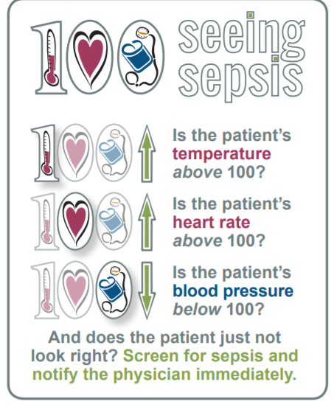
Sepsis is a Medical Emergency!
Act Fast!

Slide 12
Treatment for Sepsis
Early identification
  every hour a resident does not receive antibiotics the risk of death increases by 7.6%
Review Advanced Directives
Notify Physician
Contact Family
Hospitalization or treatment in community to include:
  Labs: CBC, WBC, lactate level, blood cultures
  IV Fluids at a fast rate
  Antibiotics
  Oxygen Therapy
  Monitor organ failure, pain control, symptom relief and comfort care

Slide 13
What else can we do as healthcare providers?
Hand hygiene
Great infection control practices
Sterile techniques and maintenance of foley catheters, IV’s, etc.
Antibiotic Stewardship
Educate each other
Educate families and residents
Add sepsis education to Stay Healthy at Home binders
Flu and pneumonia vaccinations
Home Health referrals for all diagnosis of sepsis

Slide 14

a
Questions?
Pat McBride
VP of Clinical and Compliance
Christian Living Communities
pmcbride@clcmail.org
Nathalie Knopp
Director of Clinical Staff Development
Christian Living Communities
Nknopp@clcmail.org

Slide 15

How to Not Ignore Sepsis
Ashley Mines, PA - Personal Story
At this point, play:
Video – How to Not Ignore Sepsis

Slide 16
34 y.o. healthy female with “bronchitis”
2 weeks cough, congestion
Yellow sputum
Worsening endurance/fatigue
Assumption = “URI with asthma or bronchitis”
Reality = pneumonia (and about to get worse)

Slide 17
Things got worse
Poor appetite
Sleeping/fatigue
Salmon-orange sputum
Fevers/chills
Right CVA tenderness
Loose stools
Vomiting
Dizziness
Anuria
Assumption: URI with asthma flare and Noro/flu and pulled muscle
Occam’s razor (maybe simpler explanation)

Slide 18
Litteton Adventist
Immediate ER room, IV lactated ringers, and central line
Vitals: BP <90/50, tachycardia 110’s, low pulse ox 70%
Triple abx: azithromycin, vancomycin, ceftriaxone
IV Solumedrol then oral Prednisone
Rocky Mountain ID: Dr. K Coulter
CCPC and CPI with ICU
Incentive and acapella spirometer
“easy” pep nebs (torture device)

Slide 19
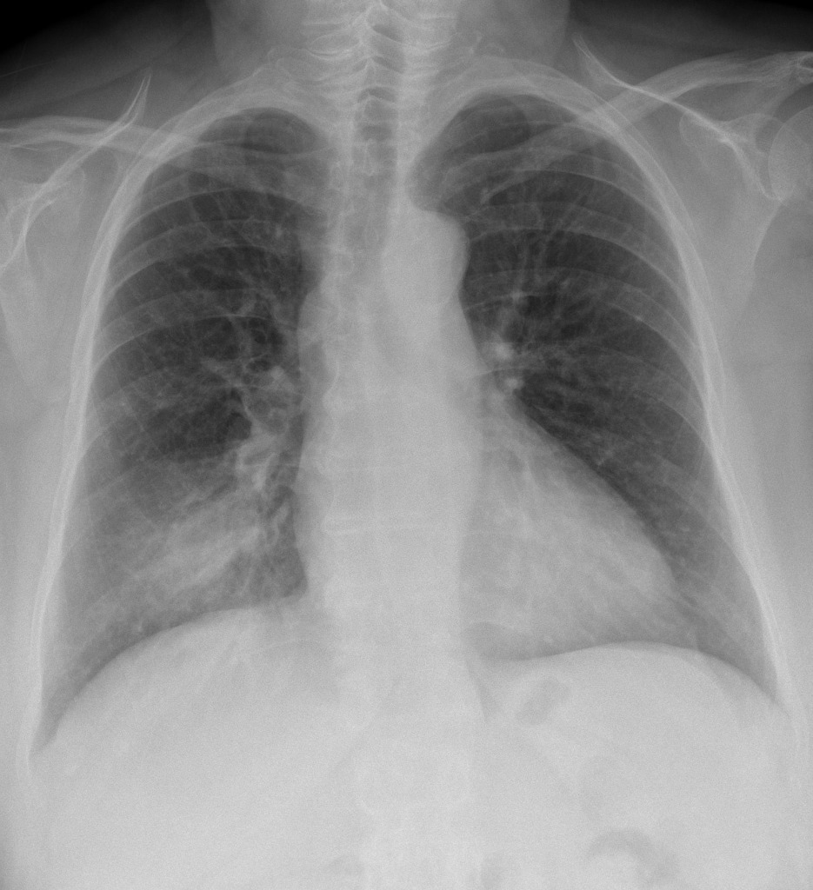
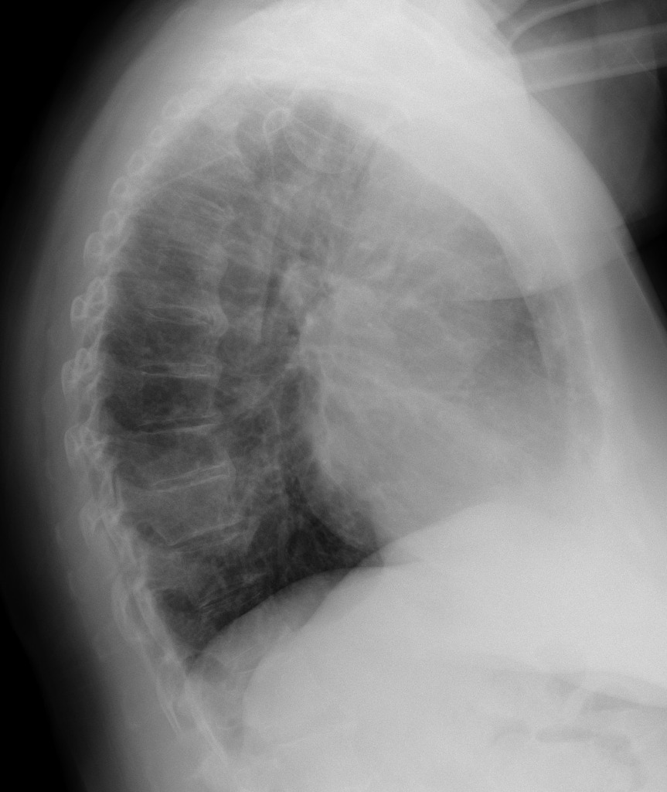
CXR/CT results
CT lungs: “near complete consolidation of RLL” and Right > Left pleural effusion
RLL pneumonia with sepsis

Slide 20
Labs
Lab | Initial | Worse | Upon DC
WBC | 5.8 (normal) | 13 (high) | 14.7 (high)
Lactate | 3.5 (high) | 5.5 (high) | 1.9 (normal)
Cr | 1.81 (high) | 0.77 (normal) | 0.88 (normal)
GFR | 36 (low) | 101.1 (normal) | 86 (normal)
Sodium | 137 (normal) | 144 (normal) | 142 (normal)
Magnesium | 1.3 (low) | 1.9 (normal) | 2.2 (normal)
Phosphorus | 2.9 (normal) | 1.8 (low) | 2.3 (low)
Blood Culture Results: Streptococcus pneumoniae

Slide 21
Follow advice
Ambulation
Fluid restriction
Healthy foods
REST
Listen to your nurse!

Slide 22
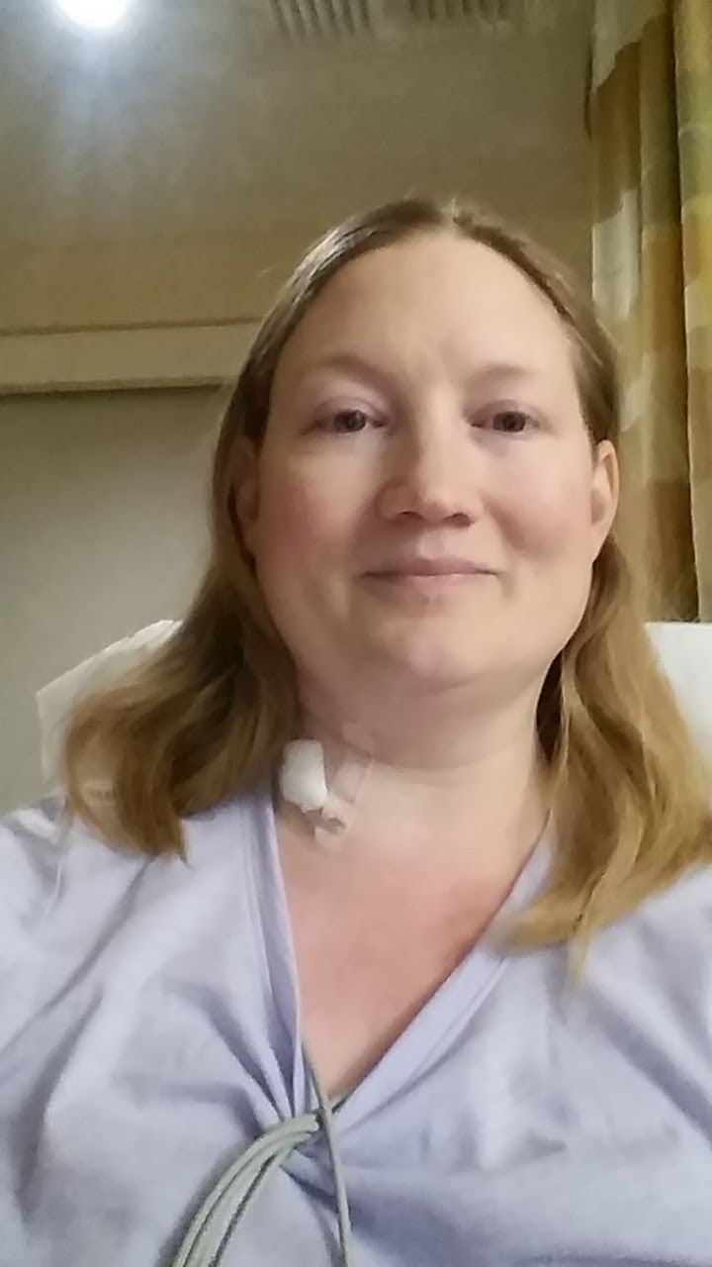
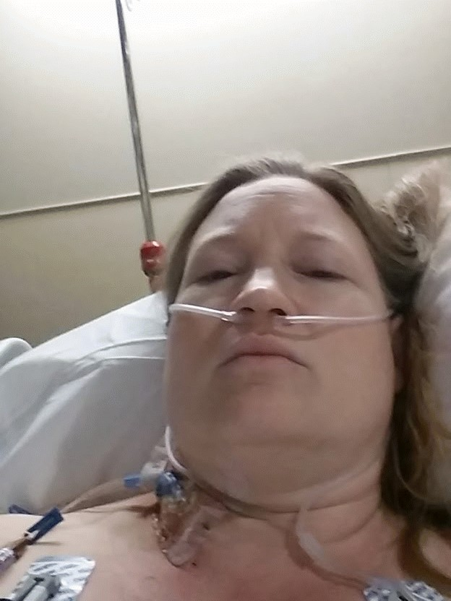
Instagram Worthy

Slide 23
Pearls
Avoid assumptions
Remember sepsis on differential
“Gut feeling”
change in condition
Thank you for all the care you provide!

Slide 24
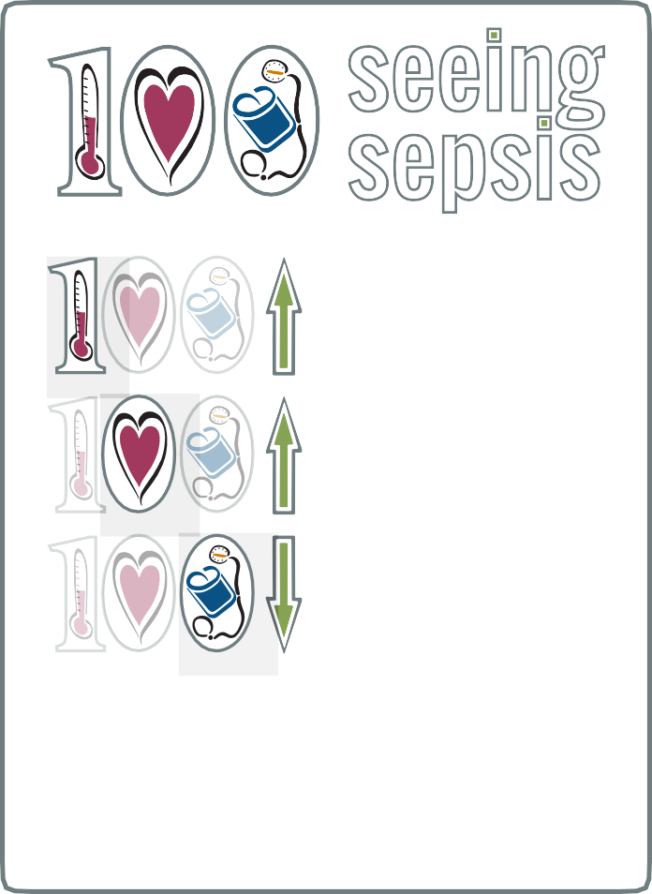
ACT FAST!
Early detection of SEPSIS requires fast action
If resident has suspected infection AND two or more:
Every hour a resident in septic shock doesn’t receive antibiotics,
the risk of death increases 7.6%
Call the doctor!
Temperature >100°F or <96.8°F Pulse >100
SBP <100 mmHg or >40 mmHg from baseline Respiratory rate >20/SpO2 <90%
Altered mental status
•
•
•
•
Plan for:
•
Review advance directive Contact the physician Contact the family
•
•
If transferring resident to hospital:
Prepare transfer sheet Call ambulance
Call in report to hospital Report positive sepsis screen
•
•
•
If resident stays in facility, consider options below that are in agreement with resident’s advance directives:
Labs: CBC w/diff, lactate level (if able) UA/UC, blood cultures, as able from 2 sites, not from lines
Establish IV access for IV 0.9% @ 30ml/kg Administer IV, PO or IM antibiotics
Monitor for worsening in spite of treatment, such as:
•
•
•
Is their temperature above 100?
Is their heart rate above 100?
Is their
blood pressure
below 100?
And does the resident just not look right? Tell the nurse, screen for sepsis and notify the physician immediately.
•
•
•
•
Urine output <400ml in 24 hours SBP <90 despite IV fluids Altered mental status
•
Comfort care:
•
•
•
•
•
•
•
Pain control Analgesic for fever
Reposition every 2-3 hrs Oral care every 2 hrs Offer fluids every 2 hrs Keep family informed
Adjust care plan as needed
•
Consider transferring to another level of care such as palliative care, hospice or hospital

Slide 25
a
SDCC Sepsis Initiative
Train the Trainer tools available on
http://southdenvercc.org

